Slide 1


Slide 2


Slide 3
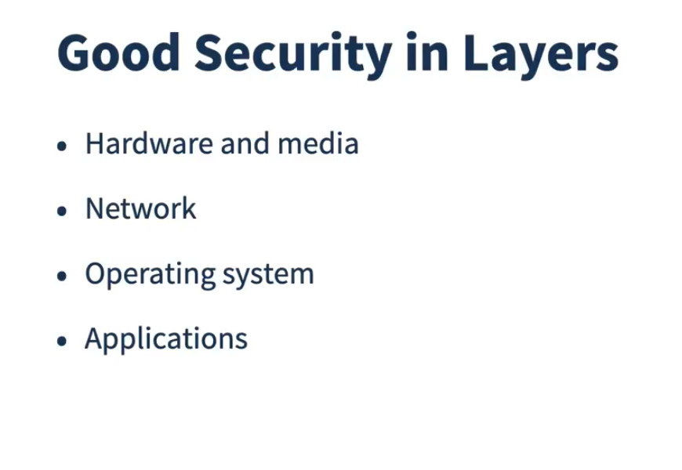

Slide 4


Slide 5
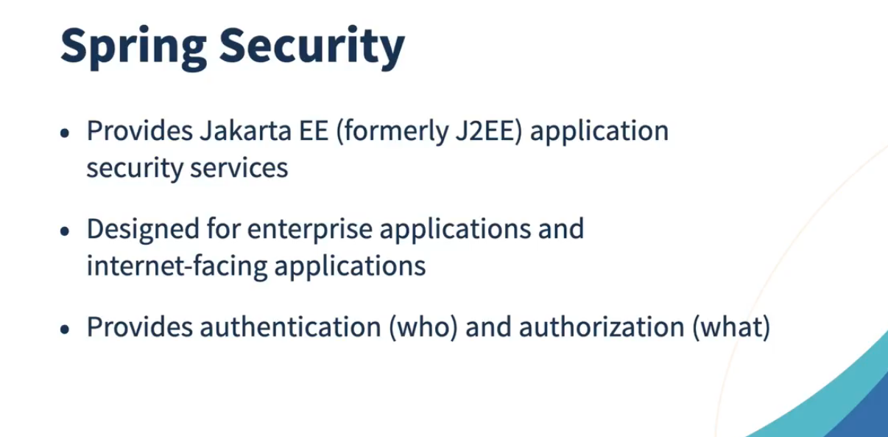

Slide 6


Slide 7
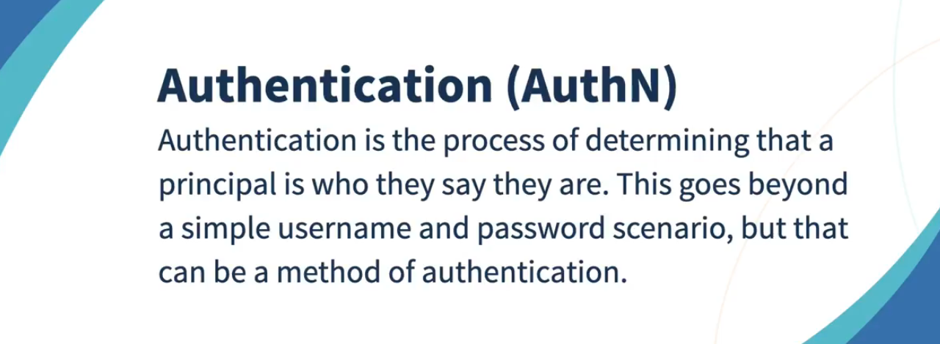

Slide 8


Slide 9
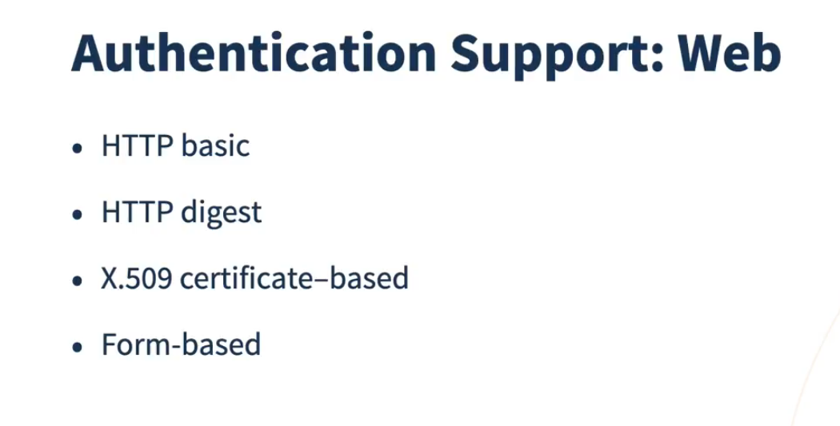

Slide 10
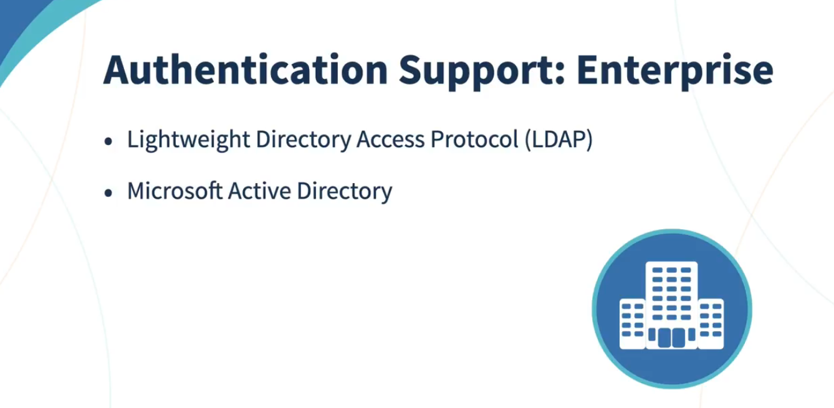

Slide 11
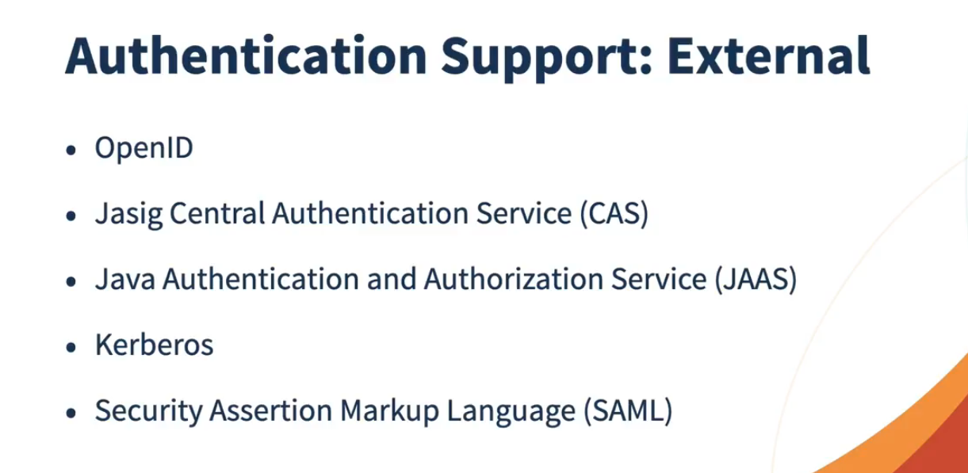

Slide 12
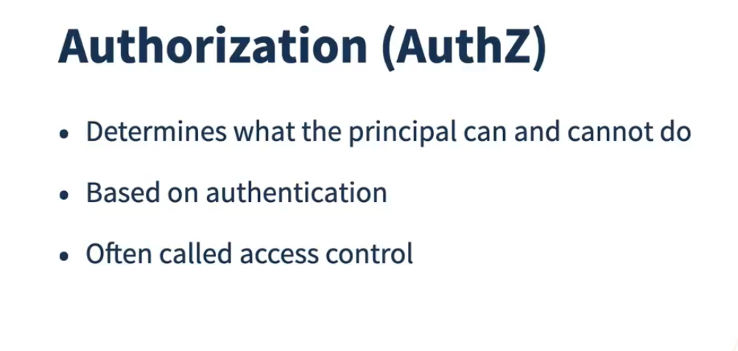

Slide 13
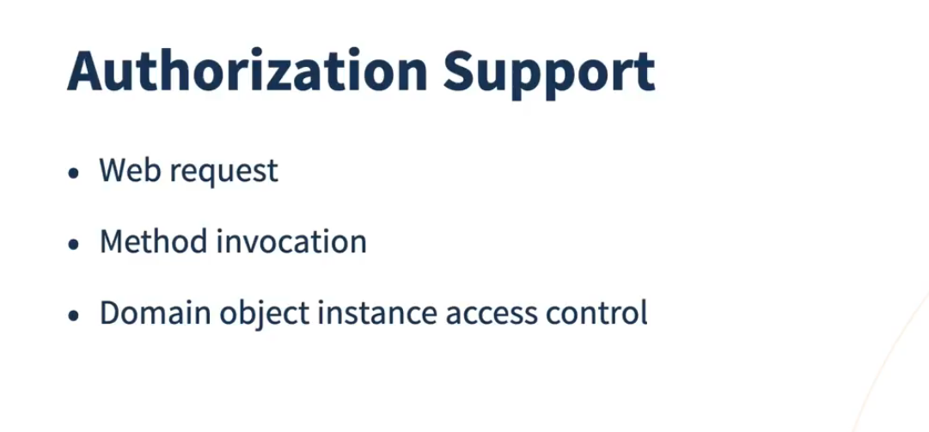

Slide 14
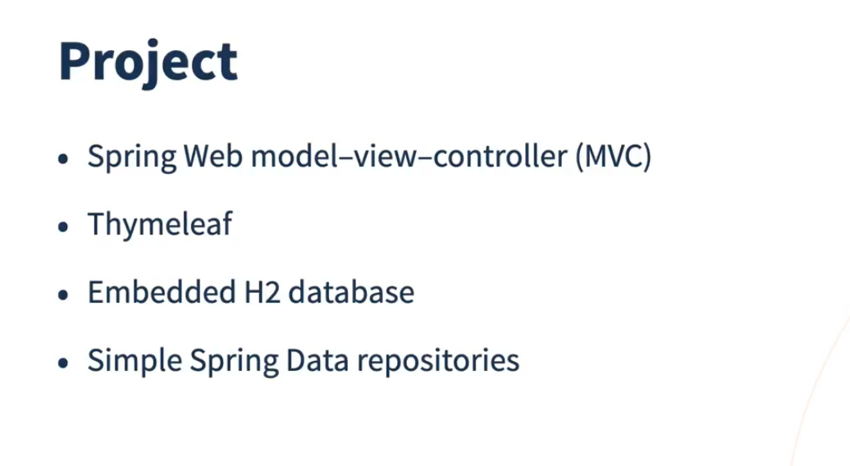

Slide 15


Slide 16


Slide 17


Slide 18
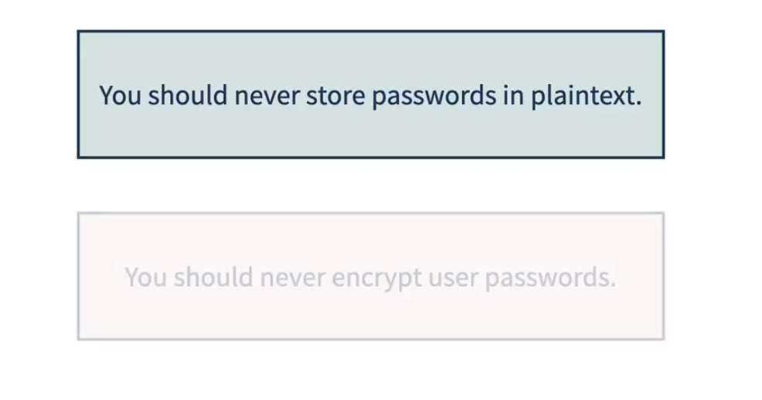

Slide 19


Slide 20


Slide 21
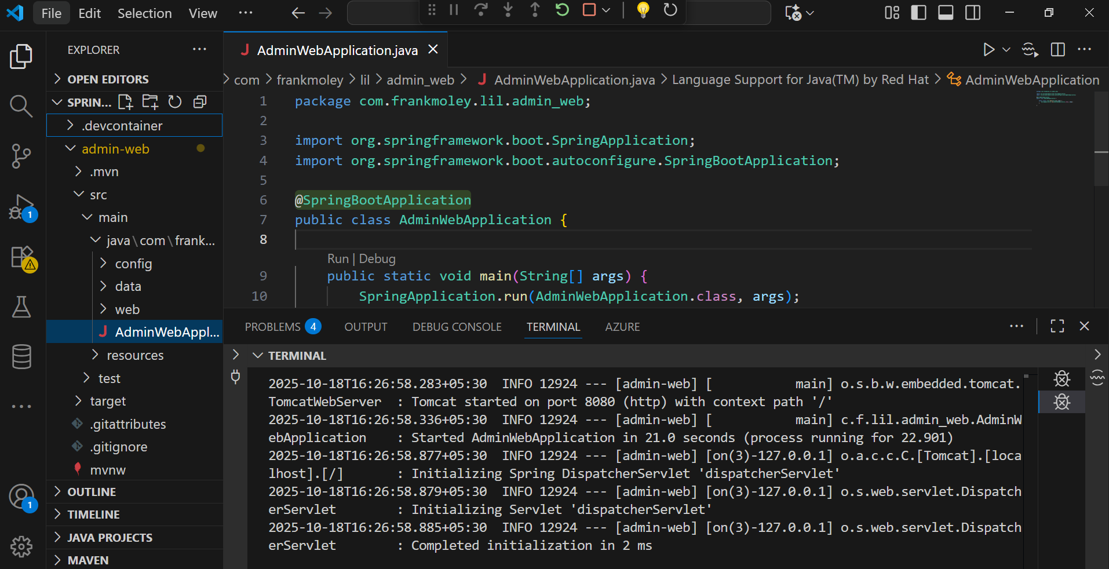
Notes:
C:\AWS-DevOPS\VP\All Courses\Microservices - Cloud Native\Demos\08-Spring-Security\spring-6-spring-security-5985041-02_09b\admin-web

Slide 22
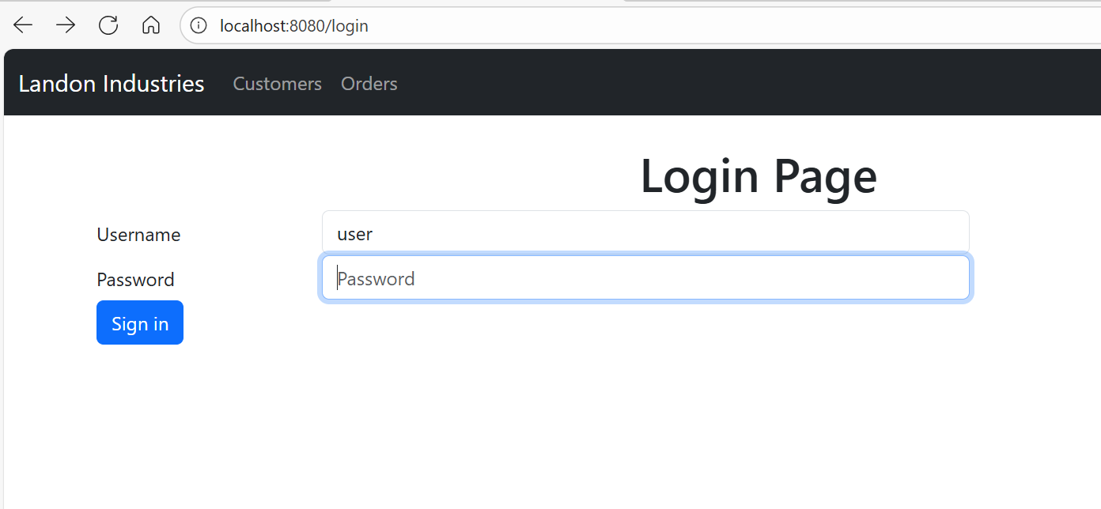
passwordjdbc

